Slide 1
One SHOT face swapping
M8O-107M-21

Slide 2
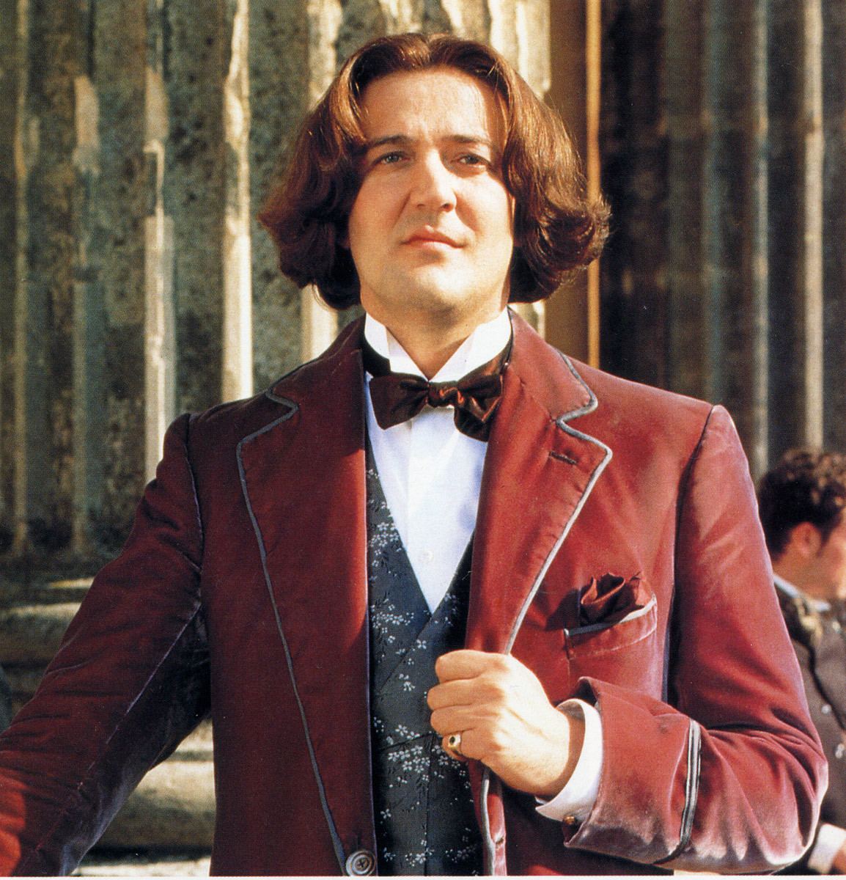
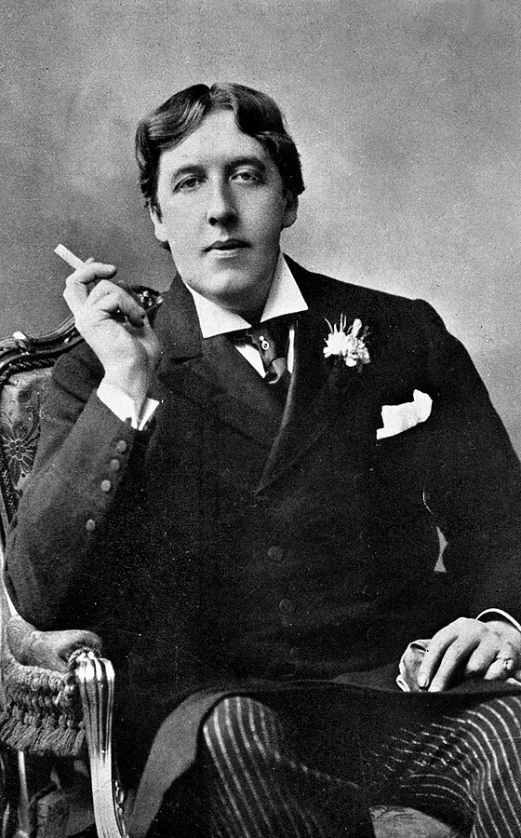
Original images
Target Image
Source Image

Slide 3
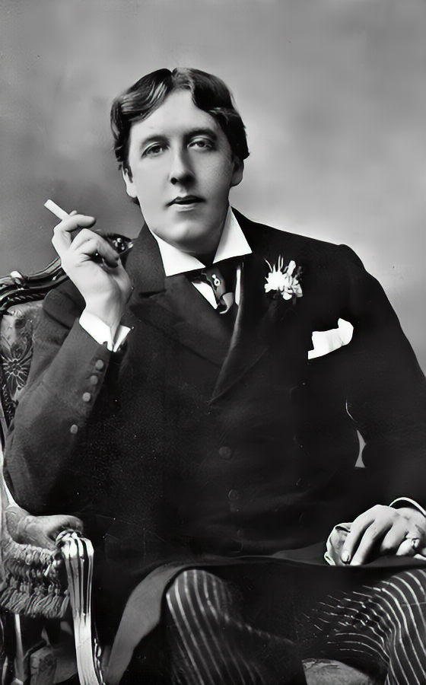
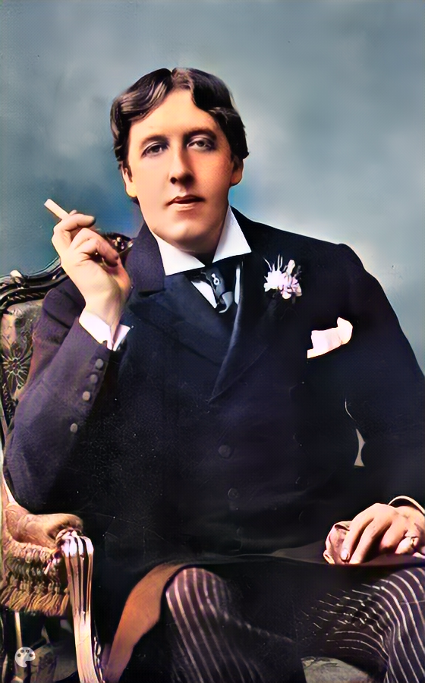
Enhancing THE Source image
Bringing Old Photo Back to Life
ImageColorizerColab (DeOldify)
Original Image

Slide 4

Enhancing The Target image
Bringing Old Photo Back to Life
Original Image

Slide 5

Face Swapping result (simSwap)
Problems:
Small artifacts
Noise
Low resolution
One can see a face mask
Let’s try to enhance the image further!

Slide 6

Enhance the image with GFPGAN

Slide 7
Thank you kindly for your attention!
THE END.

